Slide 1
Algorithm Design and Analysis
4th Semester
Computer Engineering
Spring 2023
Conf.dr.ing. Ioana Ṣora
ioana.sora@cs.upt.ro
http://staff.cs.upt.ro/~ioana/algo/

Slide 2
design algorithms that are correct and efficient
Our goal:

Slide 3
Analyzing Algorithms
We need methods and metrics to analyze algorithms for:
  Correctness
    Methods for proving correctness
  Efficiency
    Time complexity, Asymptotic analysis

Slide 4
Designing Algorithms
Ok, so you will know (will learn) how to analyze a given algorithm.
But where do these algorithms come from ?
  Clever people already designed a plethora of solutions (algorithms) for different problems and we find them in textbooks, internet, etc.
  But how will you design solutions for new problems ?

Slide 5
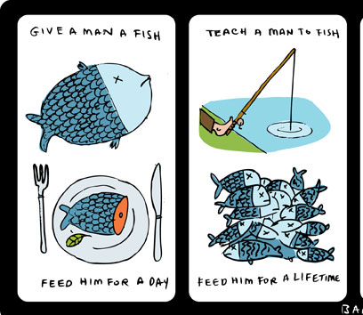
How to learn algorithms ?
http://www.neatorama.com/twaggies/2010/11/07/no-112-robcorddry/

Slide 6
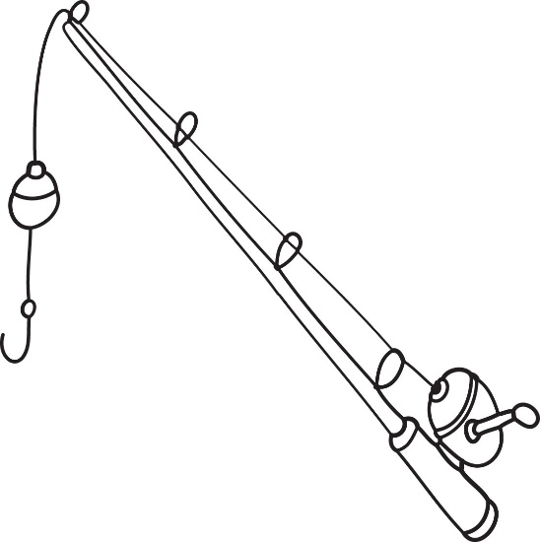

Kruskal’s algorithm
Prim’s algorithm
Design methods:
Backtracking = Forbidden ☺
Greedy
Design by Induction
Divide and Conquer
Dynamic Programming
Floyd’s algorithm
Dijkstra’s algorithm
Tarjan’s algorithm

Slide 7
What about data structures ?
Fundamental data structures:
  Model fundamental data
    Examples: lists, queues, stacks, hashtables, etc
    In this class you can make use of libraries providing implementations of these (such as: Java Collections, C++ STL Containers)
Special data structures:
  Created to optimize a specific (set of) operation(s) for a specific context of a specific class of algorithms
    Examples: Search trees, balanced trees, optimal trees, disjoint sets, etc

Slide 8
Course Goals
Learn to design algorithms that are correct and efficient
  How do we know that:
    an algorithm is correct ? -> correctness proofs
    an algorithm is efficient ? -> analysis of algorithms (time complexity)
  How to design solutions for new problems ?
    Learning general techniques for design
    Studying a set of well-known algorithms, to serve as examples of success stories for applying general design techniques
Become aware that good algorithms are key parts of software engineering practice !

Slide 9
Examination and Grading
Final grade = 2/3 final exam + 1/3 work during the semester
Final exam:
  Short questions and Algorithm design problems
Work during the semester:
  Each lecture topic is followed (next week) by an associated lab session. Have to come prepared to the lab !
  Lab class activity, including quizzes/test
  Lab assignments, including homeworks
Bonus points: doing some optional work, you can gain bonus points for your exam grade!
  staff.cs.upt.ro/~ioana/algo/bonus/bonus.html
  Tool projects: implementation projects, use different algorithms to solve different practical tasks

Slide 10
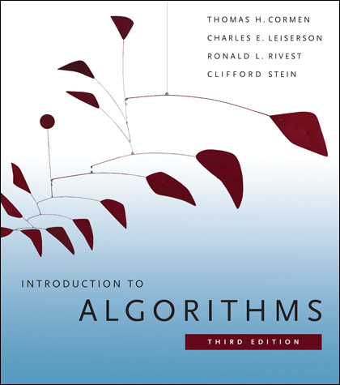
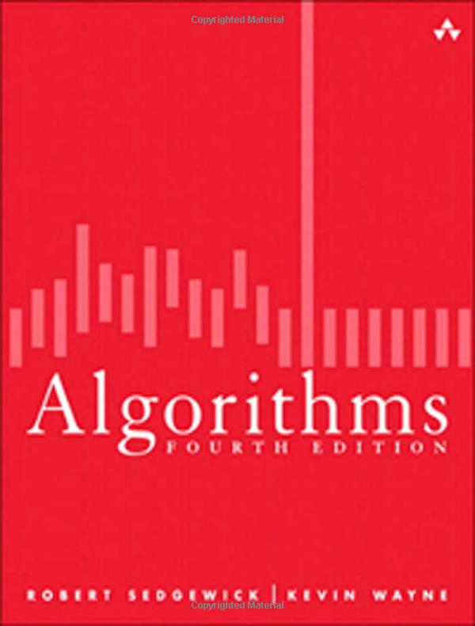
Textbooks
[CLRS]
[Sedgewick]

Slide 11
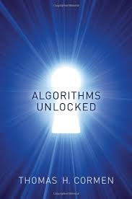
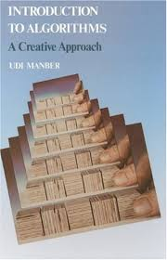
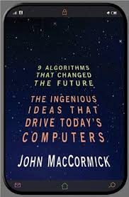
Other books
[Unlocked]
[Manber]
[McCormick]

Slide 12
Course Webpage
All official information related to the Algorithm Design and Analysis classes:
Campus Virtual
https://cv.upt.ro/course/view.php?id=1642
and
http://staff.cs.upt.ro/~ioana/algo/

